Slide 1

AWS Lambda and other coding services ICTICT426 - Identify and evaluate emerging technologies and practices
Presentation

Slide 2
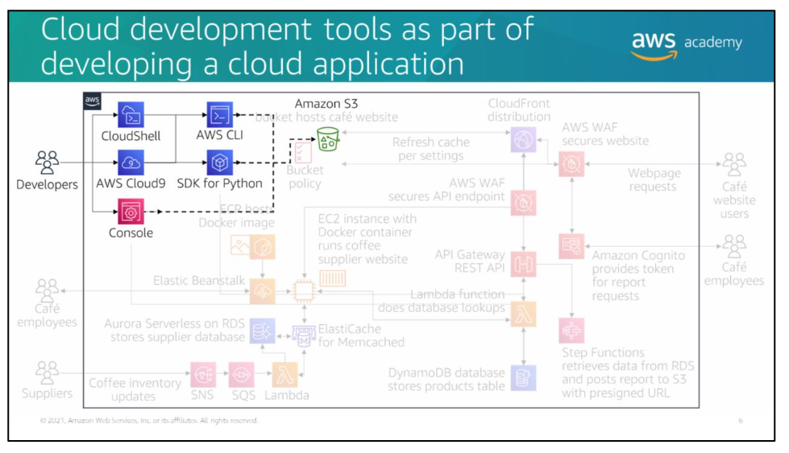

Slide 3
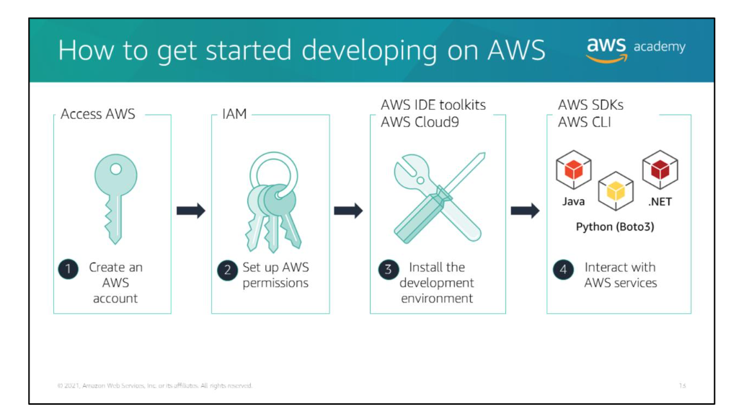

Slide 4
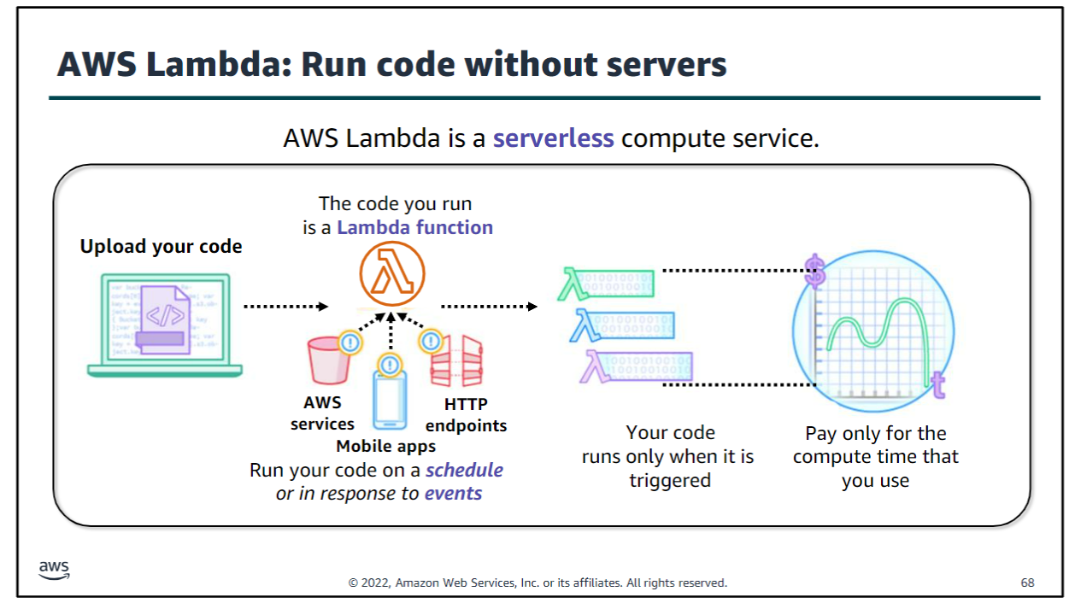

Slide 5


Slide 6
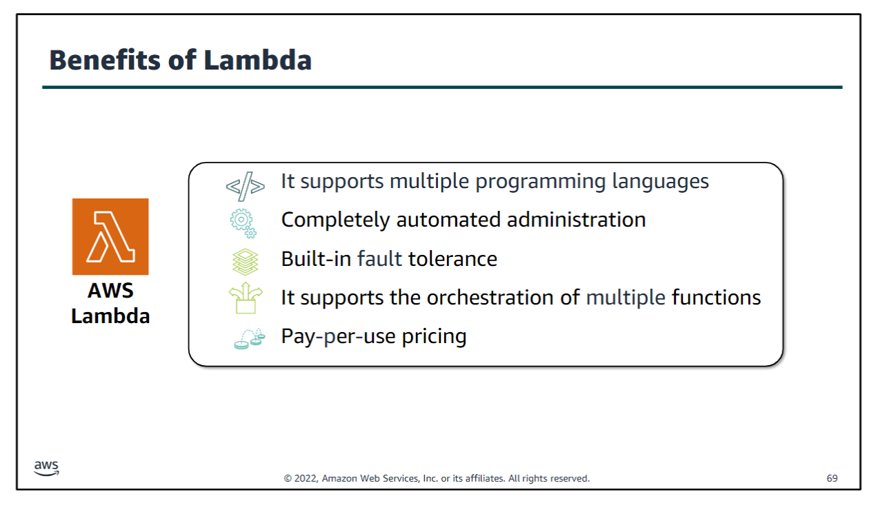

Slide 7
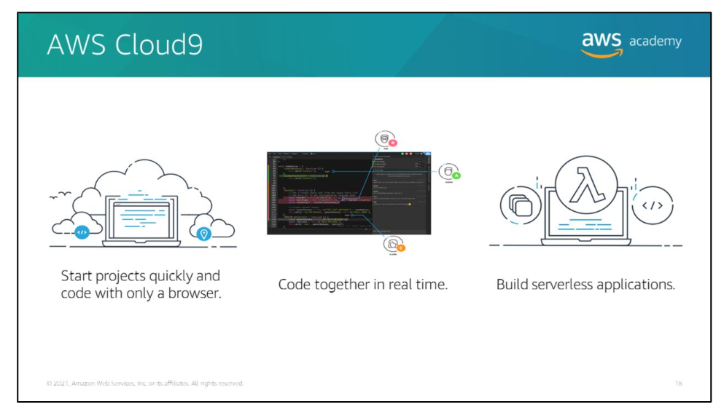

Slide 8


